Slide 1
Homeostasis
Fluid levels

Slide 2
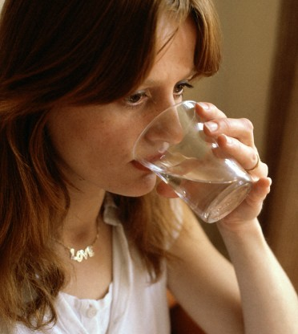
Fluid balance: Water in
Food 1000 ml
Fluids 1200 ml
Metabolic water (from respiration) 300 ml
TOTAL 2500 ml
Anthea Sieveking, Wellcome Images

Slide 3
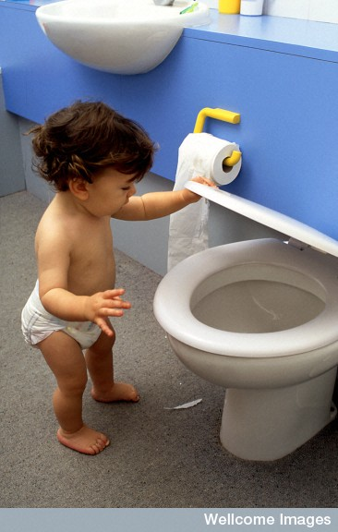
Water out
Urine 1200 ml
Sweating 750 ml
Lungs 400 ml
Faeces 150 ml
TOTAL 2500 ml
Anthea Sieveking, Wellcome Images

Slide 4
Water in the body
Approximate fluid make-up of a 70 kg person
Intracellular fluid 21 L
Extracellular fluids
Interstitial (tissue) fluid 13.8 L
Blood plasma 3.0 L
Other 0.7 L
17.5 L
TOTAL 38.5 L

Slide 5
The Kidneys
The only source of water loss that can be regulated (increased or decreased) is urine. As a result the kidneys play a crucial role as the effector in regulating fluid levels in the body.
You should be familiar with the structure and function of the kidney from your stage 2 studies last year.

Slide 6
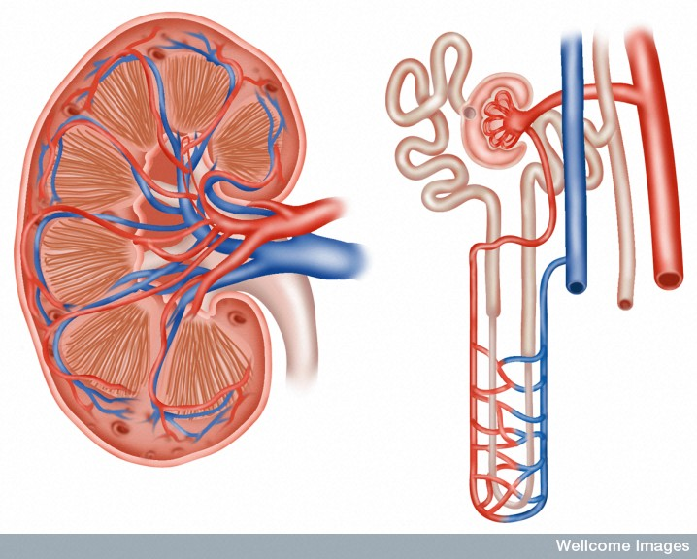
Structure of the kidney
Proximal convolute tubule
Distal convolute tubule
Capsule
Cortex
Renal corpuscle
Medulla
Pyramid
Renal artery
Collecting duct
Renal vein
Loop of Henle
Pelvis of ureter
Peritubular capillaries
Ureter
LS of KIDNEY
A NEPHRON

Slide 7
Urine formation
There are three stages in urine formation:
Filtration (in the renal corpuscle)
Selective reabsorption (mainly in the proximal convolute tubule – some water and salts are reabsorbed in the loop of Henle and the distal convolute tubule)
Tubular secretion (in the proximal convolute tubule and the distal convolute tubule)

Slide 8
Water reabsorption
60-70 % of water reabsorption occurs in the proximal convolute tubule.
The remaining 30-40 % is selectively reabsorbed in the loop of Henle, distal convolute tubule and collecting duct, depending on our state of dehydration.
The reabsorption of water in the distal convolute tubule (DCT) and collecting duct is an active transport process.

Slide 9
Receptors – measuring fluid levels
Osmoreceptors: measure the osmotic pressure of the blood.
If blood volume decreases (fluid loss) then osmotic pressure is raised.
If blood volume increases (fluid excess) then osmotic pressure is lowered.
The osmorecoptors are located in the thirst centre in the hypothalamus.

Slide 10
Behavioural response
When the thirst center is stimulated other stimuli are involved as well including a dry mouth and “feeling thirsty”
This causes the conscious part of the brain to get a drink.
This extra fluid is taken into the blood plasma from the alimentary canal increasing the blood volume.

Slide 11
The role of Antidiuretic hormone (ADH)
The thirst center (hypothalamus) will stimulate the posterior lobe of the pituitary to release ADH into the blood.
ADH targets the distal convoluted tubule and collecting tubule of the nephron tubules in the kidney.
This causes more water to be reabsorbed into the blood plasma.

Slide 12
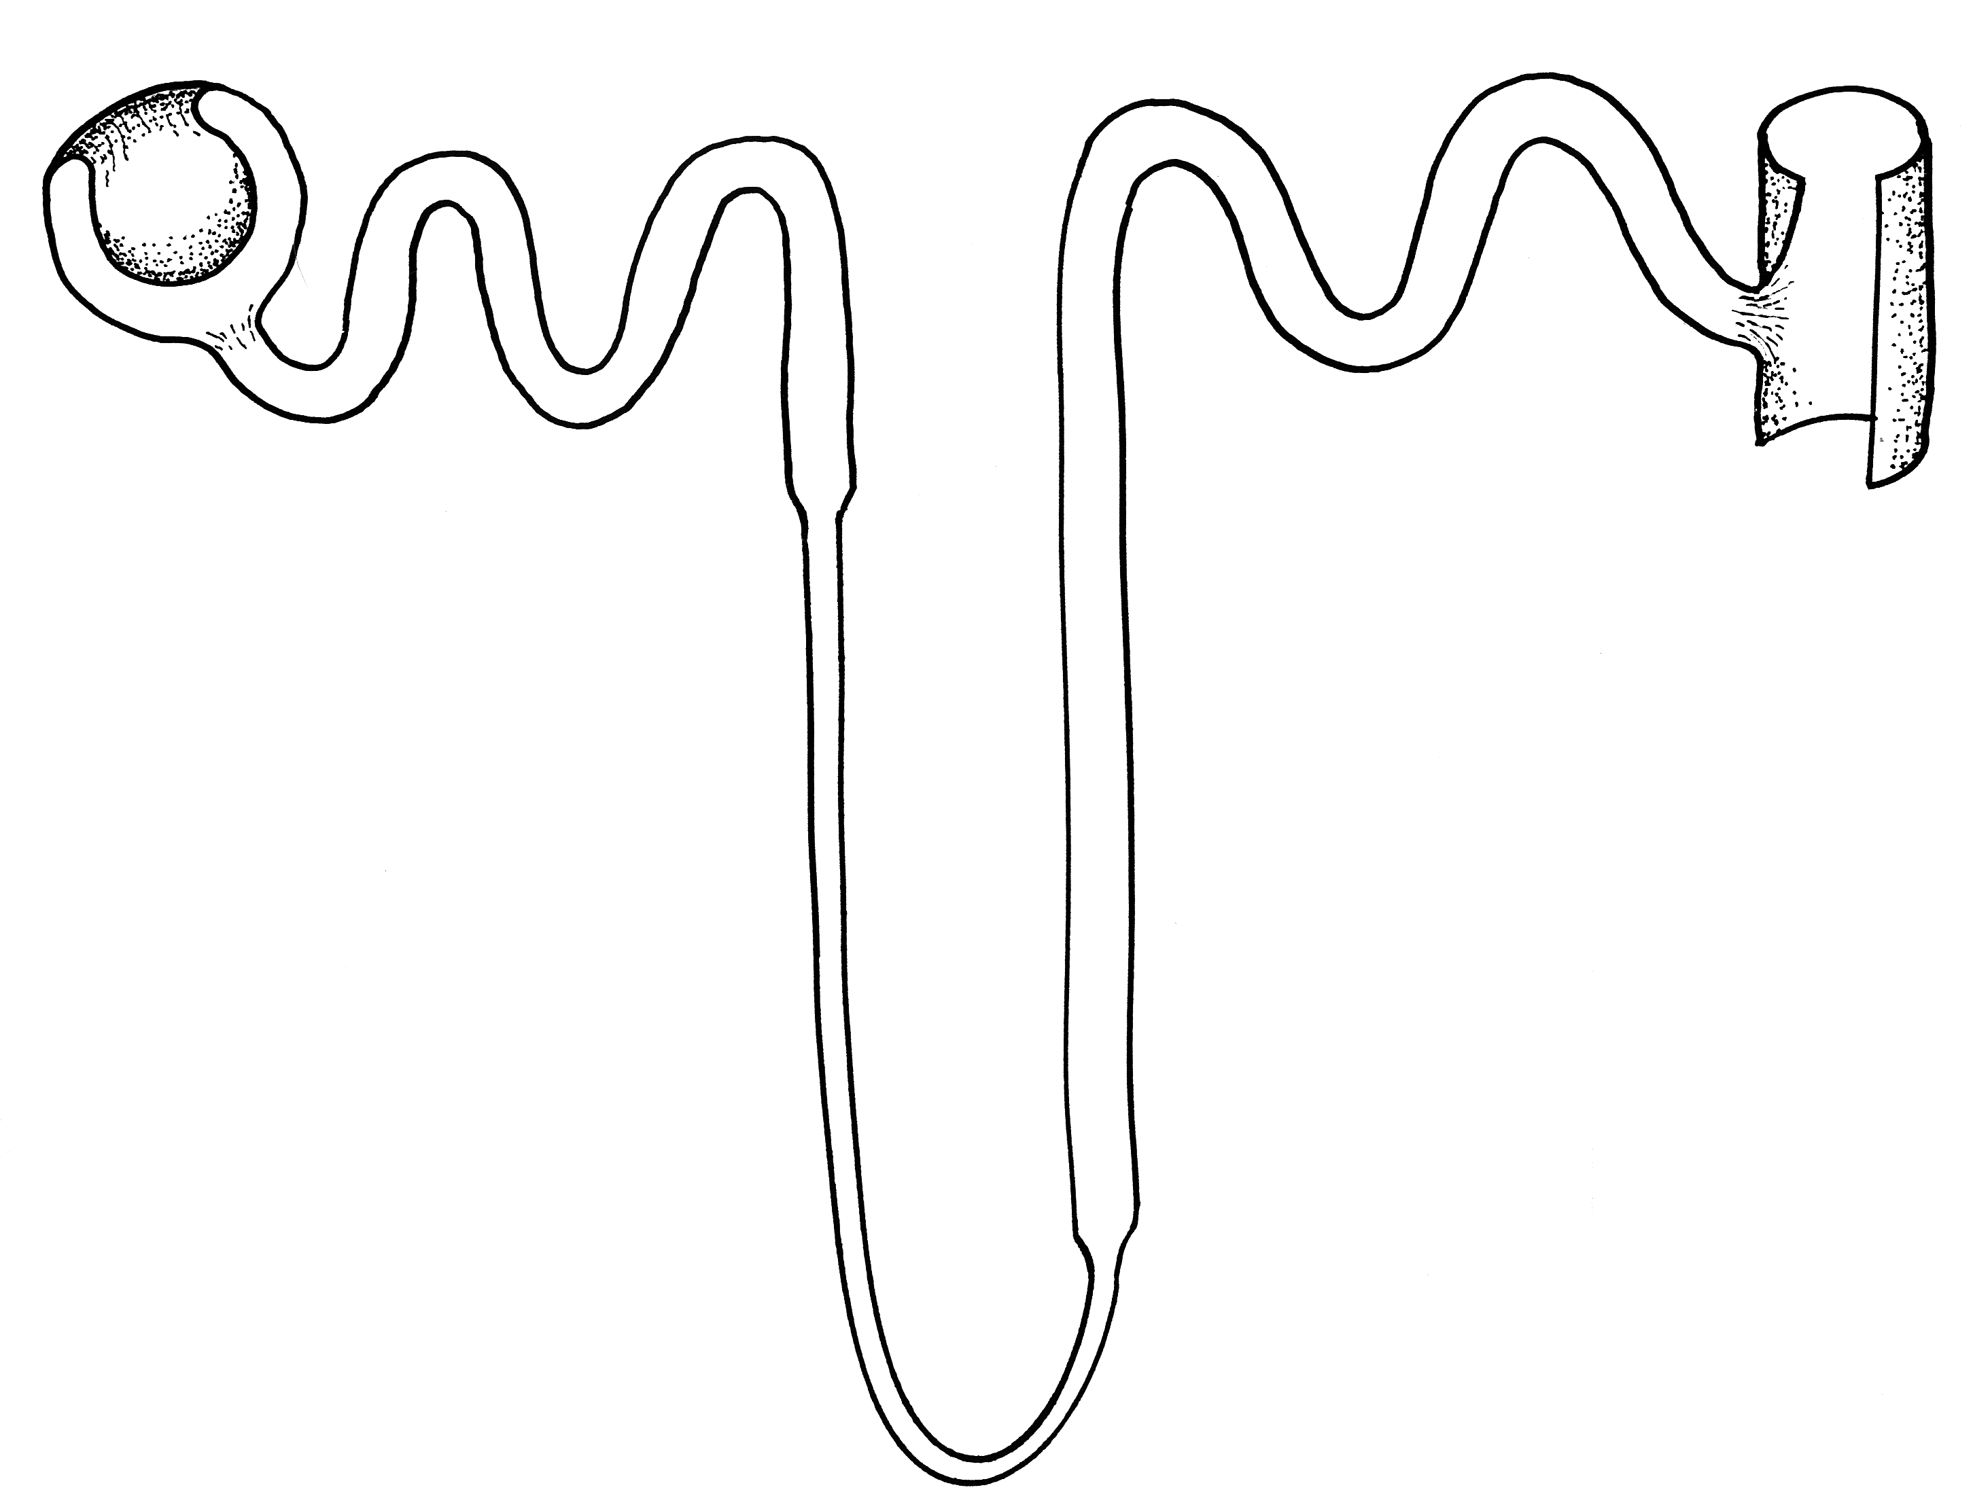
ADH increases
permeability of tubule
Relatively
dilute
filtrate
Water
leaves
the filtrate
by osmosis
Relatively
concentrated
tissue fluid

Slide 13
Negative feedback loop – low fluid levels
Decreased blood volume → reduced blood pressure → increased osmotic pressure
Osmoreceptors in hypothalamus
Stimulus
Receptor
Osmotic pressure maintained or reduced
Hypothalamus
Control
centre
Feedback
Thirst reflex
Drink
Water reabsorbed
Via posterior pituitary ADH
Response
Effector
Increases permeability of DCT and collecting duct
DCT and collecting duct

Slide 14
Negative feedback loop – high fluid levels
Increased blood volume → increased blood pressure → decreased osmotic pressure
Osmoreceptors in hypothalamus
Stimulus
Receptor
Osmotic pressure maintained or increased
Hypothalamus
Control
centre
Feedback
Water not reabsorbed, urine more dilute
Decrease in the release of ADH from posterior pituitary gland
Response
Effector
Decreased permeability of DCT and collecting duct
DCT and collecting duct

Slide 15
Dehydration
Becomes noticeable when you have lost 2% of your normal fluid levels.
Results in severe thirst, low blood pressure, dizziness and a headache.
If left untreated it will result in death.

Slide 16
Water Intoxication
When fluid levels are too high body fluids become high. Cells then will take in extra water via osmosis.
Excessive physical activity resulting in sweat (loss of fluids and salts) only being replaced by water can result in this.
Symptoms include lightheadedness, headache and vomiting.

